Slide 1
SMART Water FOUNTAIN
PHASE 4
PROJECT BY:-
M.VEDHALAKSHMI
A.SARANYA
R.MONISHA
J.REKHA
S.SOWMYA
S.G.SNEHA

Slide 2
INTRODUCTION:-
One water fountain with intelligent monitoring system based on the internet of things is discussed in this paper. The key parameters of the water fountain were derived from the sensors and transmitted the encrypted data by GPRS or WIFI net to central server automatically. The Access database was established according to the real time running data of each water fountain fixed everywhere. The unified database management and maintenance could be achieved with the PC interface application by the users or the server station administrator with different authority.

Slide 3
PYTHON CODE FOR IOT SENSOR
import time
import OS
#infinite loop to read sensors and display data
while 1:
# read ADC channels
a0 = adc.read_voltage(0)
a1 = adc.read_voltage(1)
# a2 = adc.read_voltage(2)
a3 = adc.read_voltage(3)
# convert temperature sensor voltage to temperature
temp = (a0 - 0.5) * 100
# convert soil sensor voltage to percentage soil = (a1 / 5) * 100
# convert light sensor voltage to lux
photo = 5.0 / a3 * 1000 - 100
lux = 500/(photo/1000)

Slide 4
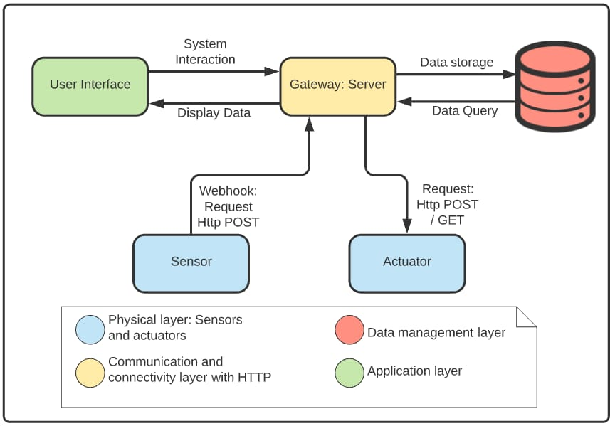
IOT architecture

Slide 5
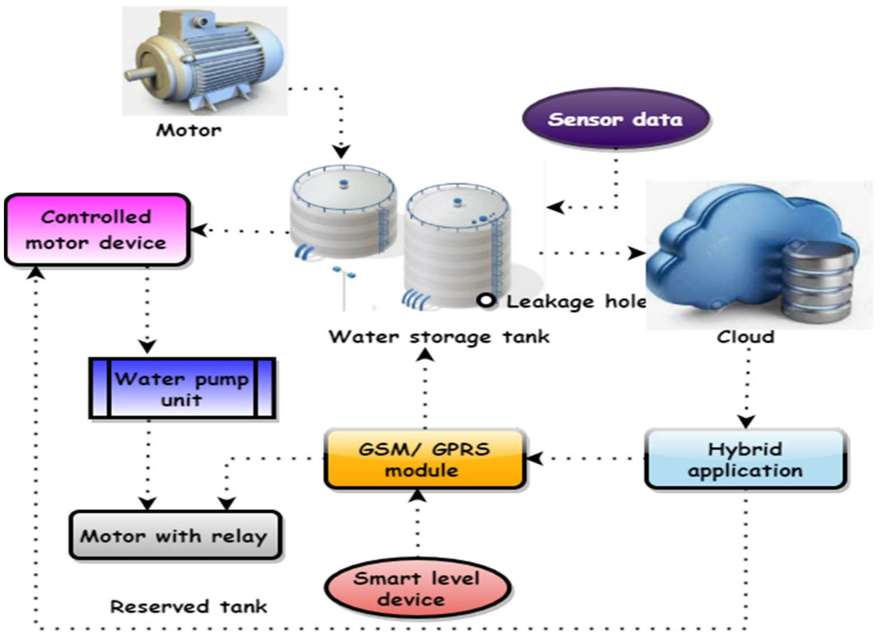
Process

Slide 6
Technology:-
The key parameters of the water fountain were derived from the sensors and transmitted the encrypted data by GPRS or WIFI net to central server automatically. The Access database was established according to the real time running data of each water fountain fixed everywhere.

Slide 7
Thank you

